Slide 1

Let’s fly to the future with forecasting.
The overall report regarding how we forecasted.
Forecasting with ML.

Slide 2

Team 5 (NEPUZB) members:
1.Izzatullokh Makhammadjonov 12194921
2.Pusparaj Bhujel 12194857
3.Abdulaziz 12194899
4. Sujan Bhujel 12194856

Slide 3
1.
About forecasting.
General information.
2.
About project in paper.
How actually it works.
How it all goes
3.
Data collection.
CONTENTS
How data is taken and why it is needed.
4.
Analisis.
To analize the data..
5.
Testing.
We will test our model with new data.

Slide 4
01
What it really is
Forecasting with ML.

Slide 5

What is Machine Learning Forecasting?
-Forecasting is the process of predicting future outcomes based on historical data. In recent years, machine learning has emerged as a powerful tool for forecasting, allowing us to make more accurate and reliable predictions.
-Machine learning algorithms are designed to learn from data and identify patterns that can be used to make predictions. By training these algorithms on historical data, we can generate forecasts for future events.

Slide 6

Applications of Machine Learning Forecasting
-Despite the challenges and limitations, machine learning forecasting has many practical applications in various industries. For example, it can be used to predict sales trends, stock prices, and weather patterns.
-Machine learning forecasting can also be used for predictive maintenance, identifying when equipment is likely to fail and scheduling maintenance before a breakdown occurs. This can help to reduce downtime and increase efficiency.

Slide 7
02
About the project
How it actually works.

Slide 8
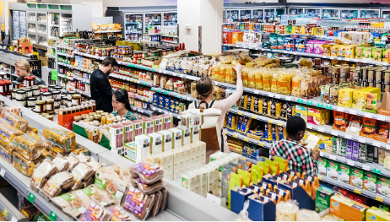

Rating methods.
-Many companies use rating methods to improve their products and services in supermarkets. By collecting feedback from customers through rating systems, companies can identify areas of their products that need improvement and make necessary changes to satisfy customer needs and preferences.

Slide 9
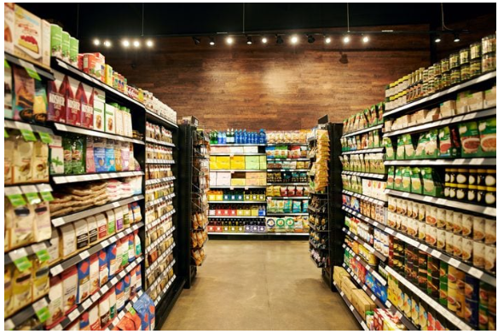

Forecasting the ratings of products in supermarkets.
The project aims to determine which segment of the market is receiving more ratings and how it is related to other factors.
Predicting product ratings and identify the market segment that receives the highest ratings.
The project has potential applications in helping supermarket branches improve their product offerings and marketing strategies to increase customer satisfaction and sales.

Slide 10
03
Modern minimalist hand-painted cartoon work summary report
Data Collection

Slide 11
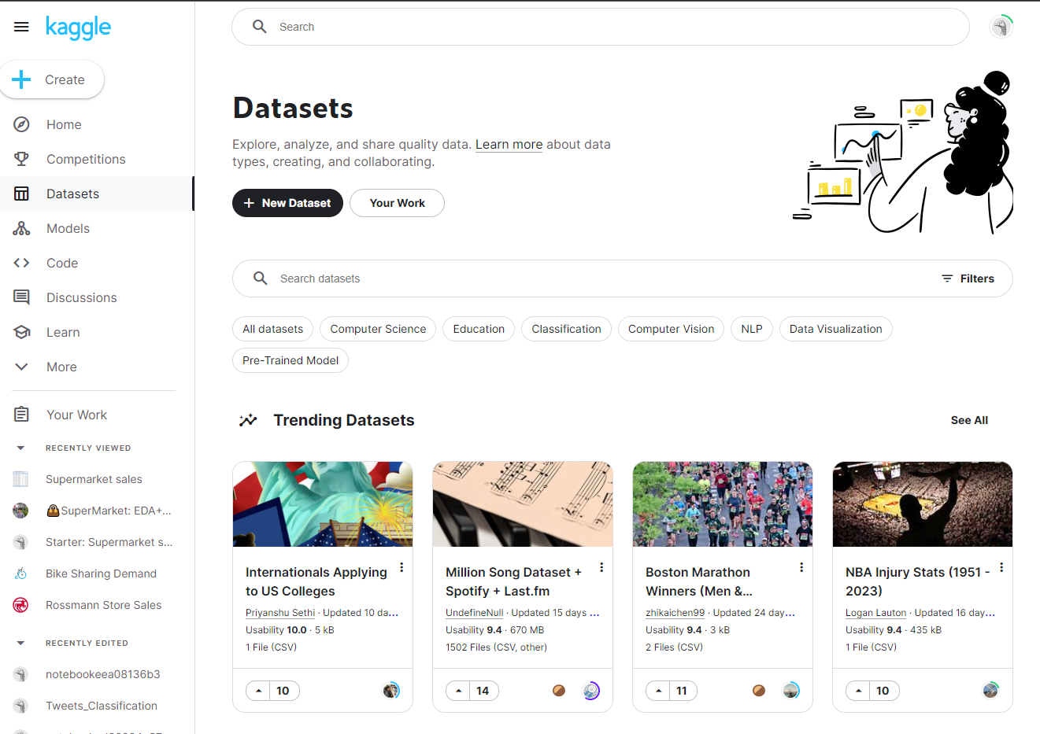
Data Collection
- Review of relevant examples - Checking the codes for sure - Help of AI for Forecasting
- Free datasets of famous companies. - Easy access - All stored in a csv files.

Slide 12
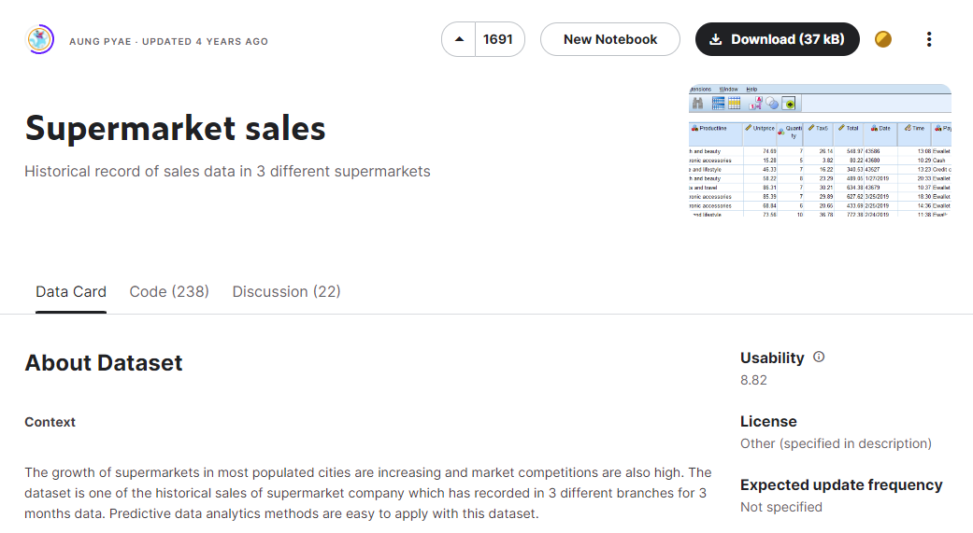
Our Data
The data we chose.

Slide 13
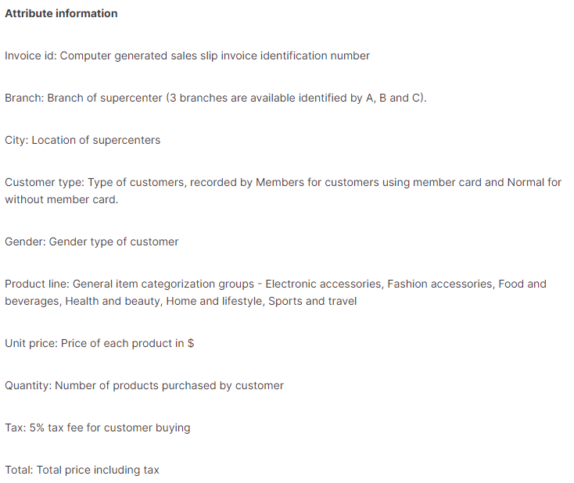
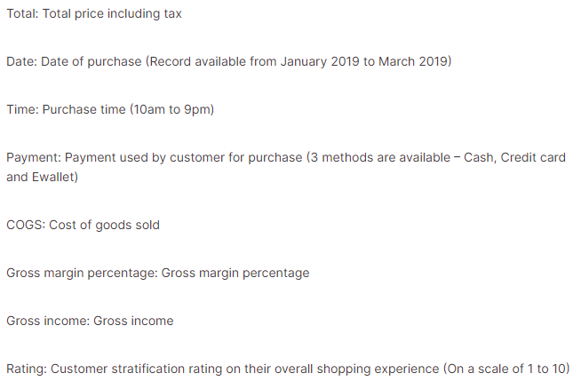

Slide 14
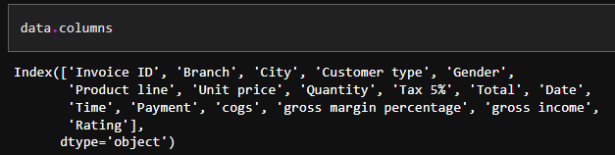
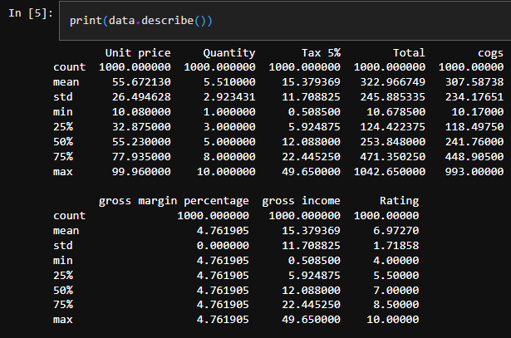
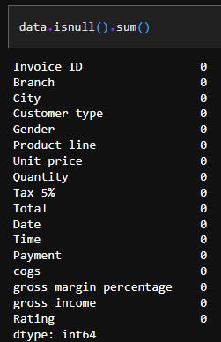
Checking the data.

Slide 15
04
Modern minimalist hand-painted cartoon work summary report
Data analisis.

Slide 16
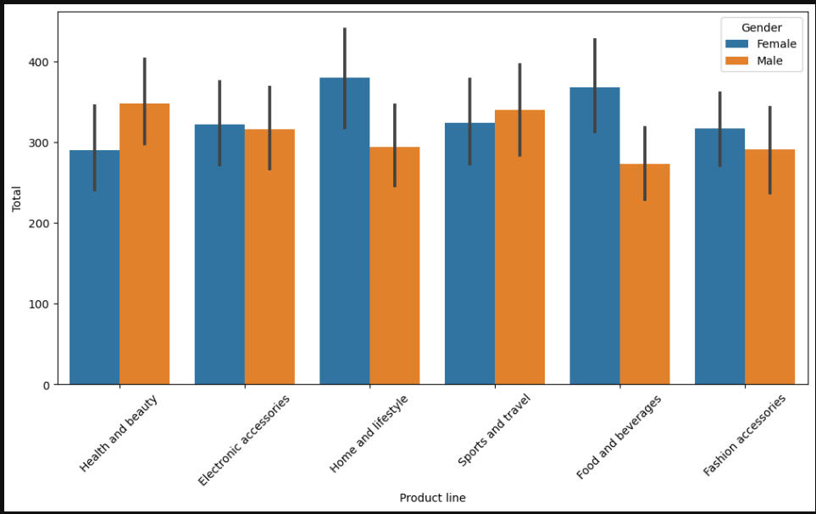
Analisis of the data.
-Whic genders are busy with which stores.
-A bar plot is ploted using a code.
-The most man are busy with food and beverage, home and lifestyle.
-The most women are on sports and travel, health and beauty stores.

Slide 17
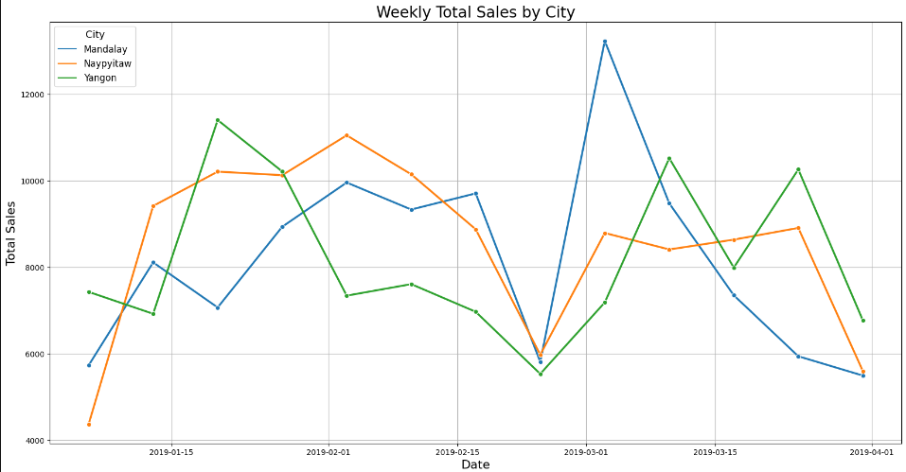
Weekly total sales analisis.
-Weekly Total Sales plot help us identify any trends or patterns in the sales data.
-For example, if we see an increasing trend in sales over time for a particular city, we may want to investigate why this is happening and try to capitalize on it.
-Conversely, if we see a decreasing trend in sales over time, we may want to investigate what is causing this and try to make changes to improve sale.

Slide 18
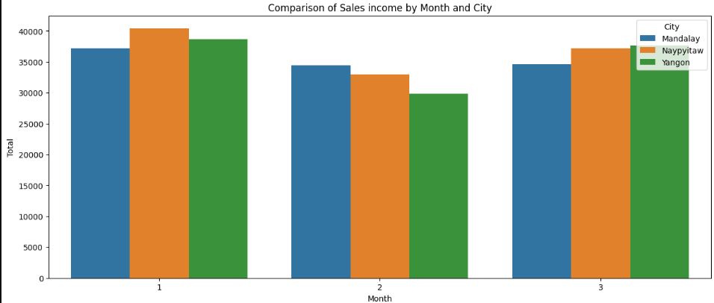
Comparision of sales income by monthe and city.
-All cities had most sales in the first month.
-And Naypyitaw got most sales.
-Sales droped in the second month and grew up in the third month again.

Slide 19
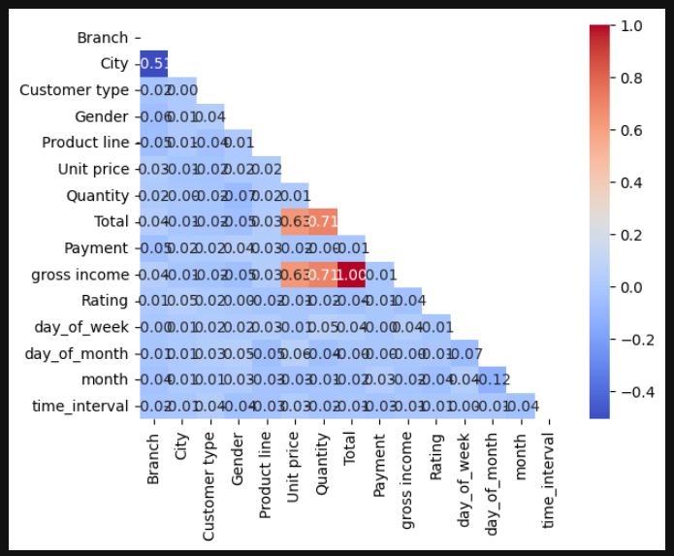
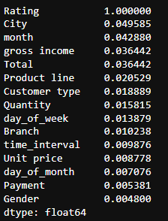
Calculating most contributing factors. CORRELATIONS.

Slide 20
05
Modern minimalist hand-painted cartoon work summary report
Testing.

Slide 21
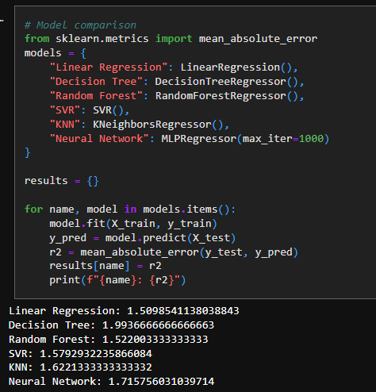
Using Mean Absolute Error to evaluate the loss.
We used 6 powerfull algorithms from Machine Learning and Deep Learning.
The models used in our analysis include Linear Regression, Decision Tree, Random Forest, Support Vector Regression (SVR), K-Nearest Neighbors (KNN), and Neural Network (MLPRegressor).
We the calculated MAE for evaluation.
We choose the one with less error.

Slide 22
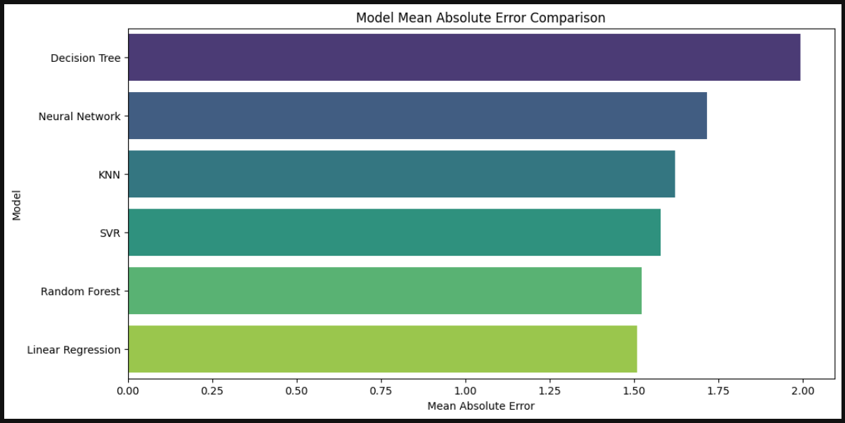
Linear Regression is having the best performance here. We choose it.

Slide 23
THANK YOU

